Slide 1
NFL Scoring Averages After the Advent of Pass Interference
Nathan Berkley

Slide 2
Question
Was the league average scoring different after the advent of the pass interference rule in 1978 than before?

Slide 3
Background
Before the advent of the defensive pass interference rule the defense could hold the opposing team’s wide receivers at the line of scrimmage.
This is relevant because the consensus in the media is that more points means more interest in watching the games, the live games broadcast by the media drives value for the NFL, and these are billion-dollar companies looking to maximize profit.

Slide 4
Data Preparation
The data was scraped from Pro-Football Reference with the use of an API developed by Ben Kite that I modified to loop through the webpages I needed data from.
Most of the cleaning was done at the CSV level to remove formatting errors and mislabeling.

Slide 5
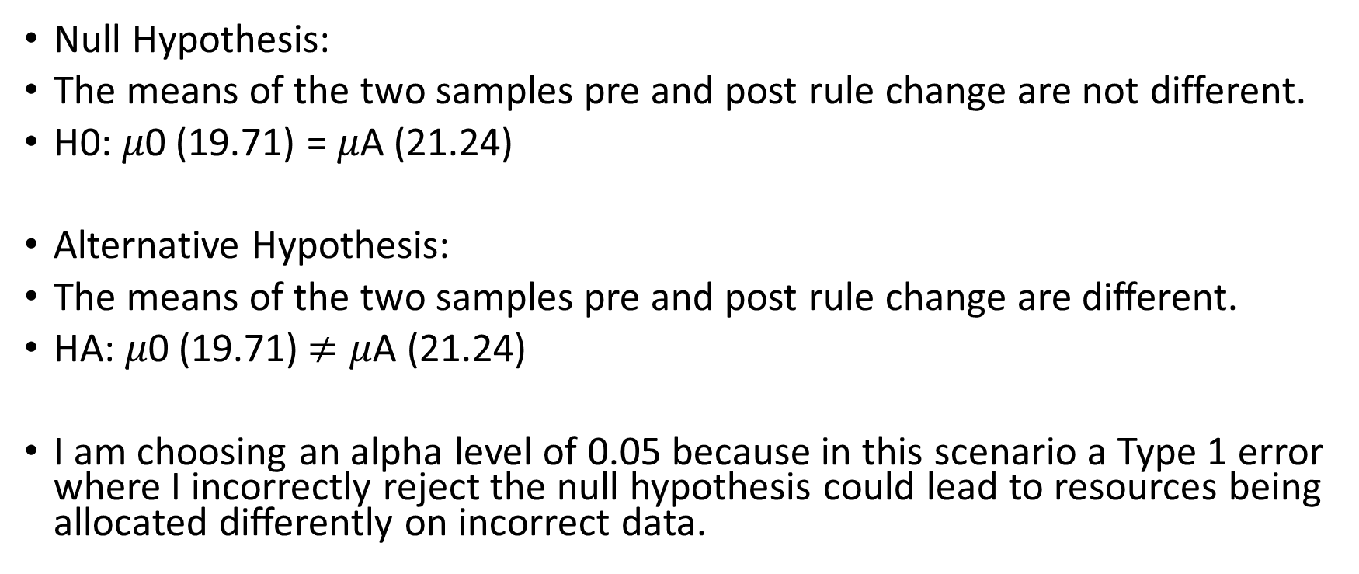
Hypothesis
Null Hypothesis:
The means of the two samples pre and post rule change are not different.
H0: 𝜇0 (19.71) = 𝜇A (21.24)
Alternative Hypothesis:
The means of the two samples pre and post rule change are different.
HA: 𝜇0 (19.71)$≠$ 𝜇A (21.24)
I am choosing an alpha level of 0.05 because in this scenario a Type 1 error where I incorrectly reject the null hypothesis could lead to resources being allocated differently on incorrect data.

Slide 6
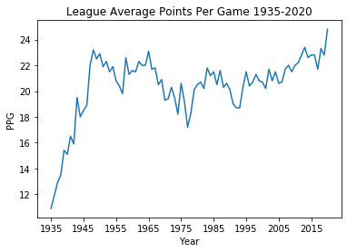
EDA

Slide 7
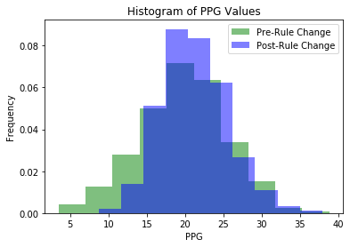
EDA

Slide 8
Hypothesis Testing
To determine my p-value I used Welch’s t-test.
The p-value was calculated to be 3.22*10^-9.

Slide 9
Conclusion
At a significance level of 0.05 and a p value of 3.22*10^-9 I reject the null hypothesis that there is no difference between the sample means.
Important to recognize that the difference between the means is small, but is statistically significant.

Slide 10
Sources
Data Source:
https://www.pro-football-reference.com/
API Link:
https://github.com/BenKite/football_data/blob/master/profootballReferenceScrape.py

